Slide 1
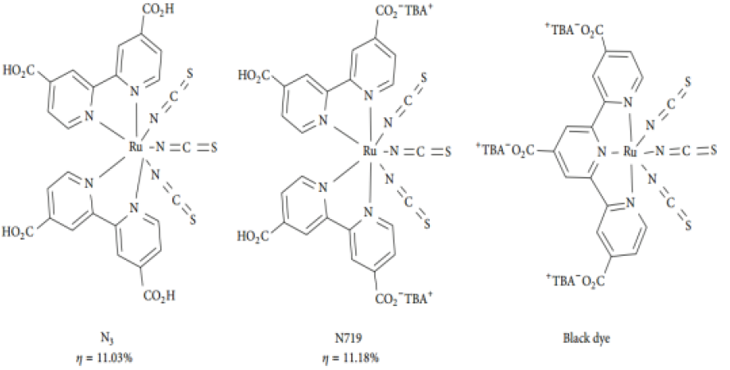

Slide 2
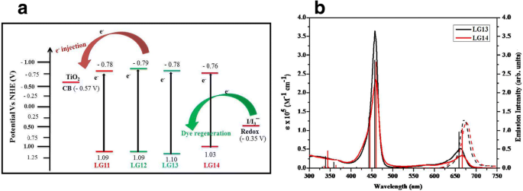
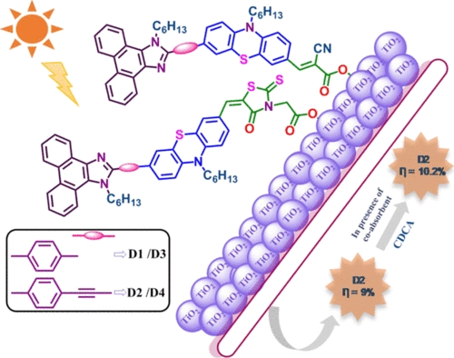

Slide 3
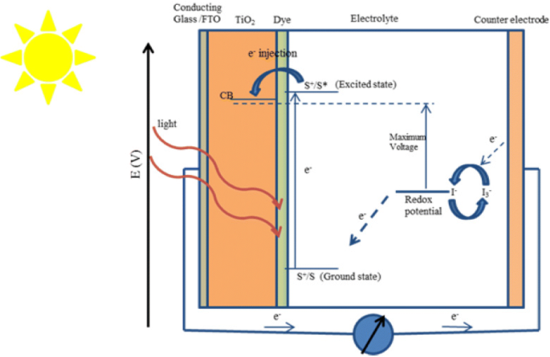

Slide 4
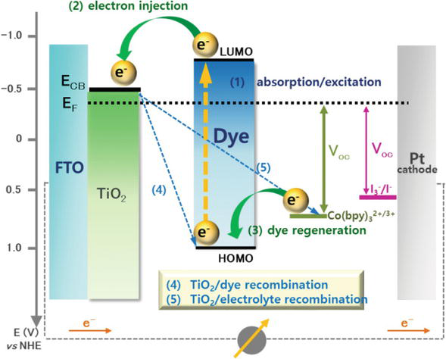

Slide 5
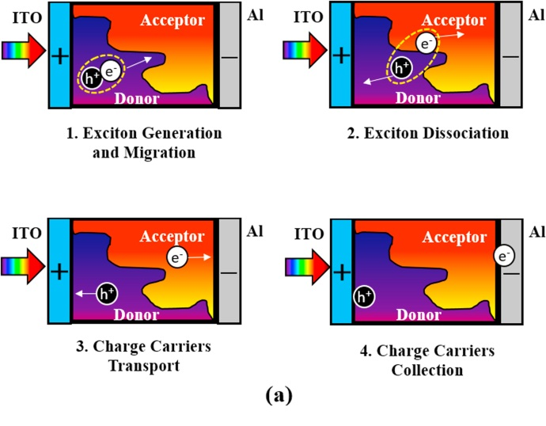
Bulk Heterojunction solar cells
Absorber layer constitutes conjugated polymer structure or dye pigments – Donor layer
Fullerene derived materials – Acceptor layer
Electron transporting layer (ETL) and hole transporting layer (HTL) are used:
Conductivity of polymer and fullerenes are very low to promote the charge carrier migration process.
Carrier diffusion length is very small and recombination chances are very high.
ETL materials: CB of ETL should be lower than that of excited state of donor-acceptor mixture – ZnO/TiO2
HTL materials: VB of HTL should be higher than ground state of donor

Slide 6
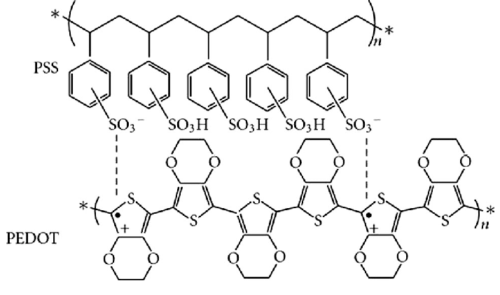

Slide 7
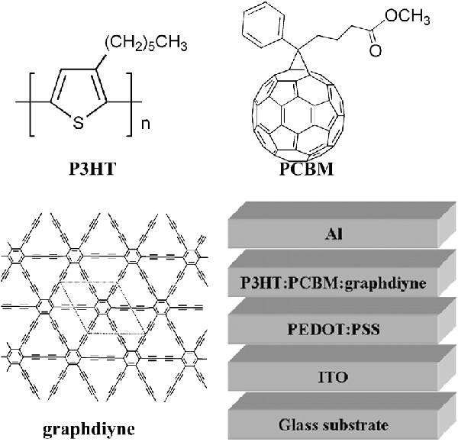
Limitations:
Mixing of two entities is extremely difficult and physical separation often occurs.
Toxic solvents such as chlorobenzene or chloroform are used to dissolve the functionalized compounds
Low carrier mobility
Narrow wavelength absorption
Low density of charge carrier generation
Susceptible to degradation with moisture

Slide 8
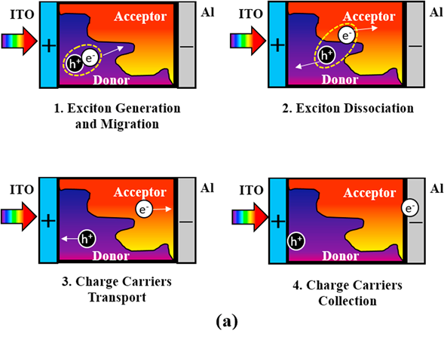
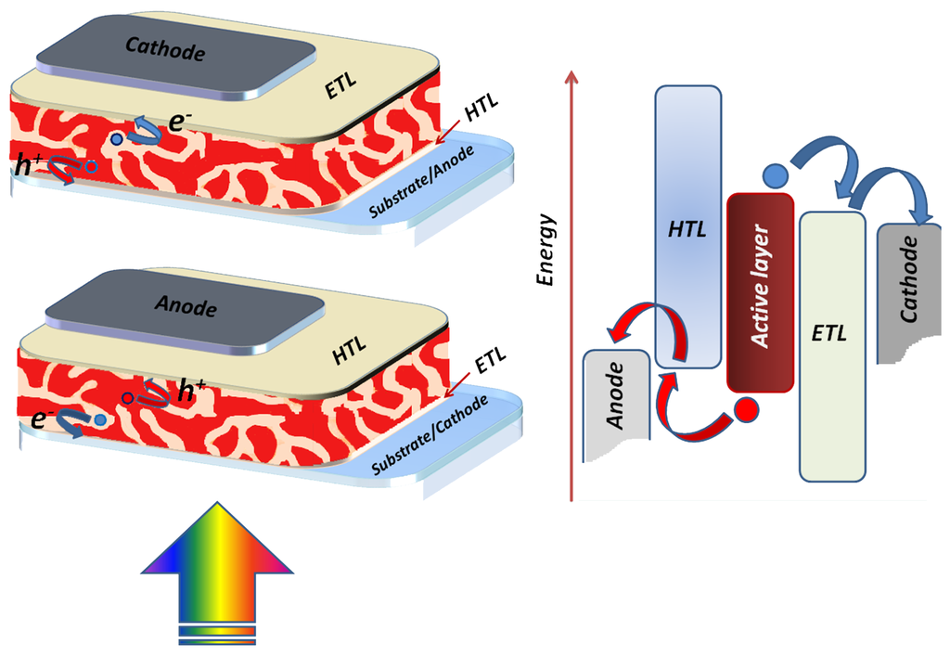

Slide 9
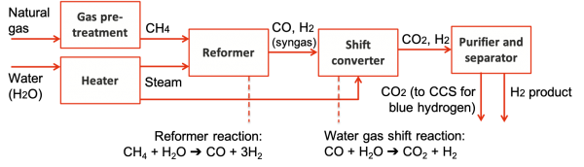
Conventional production of hydrogen gas

Slide 10
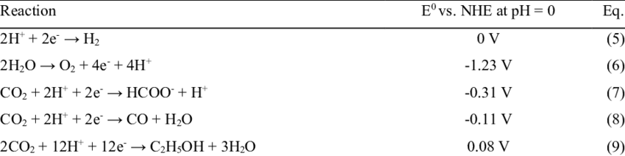

Slide 11
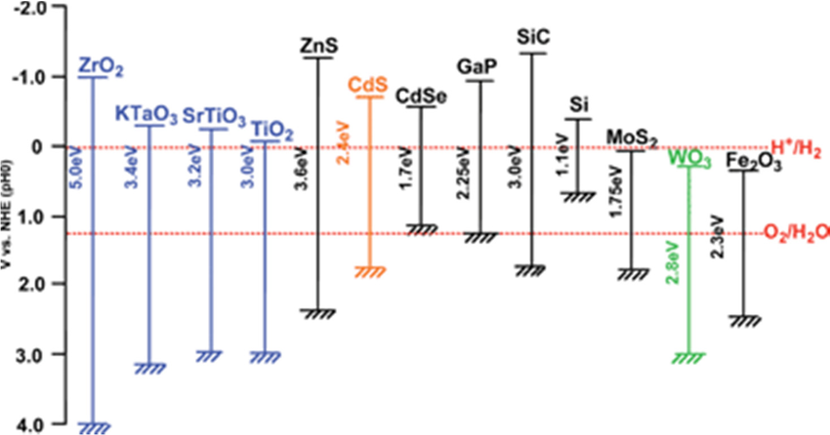

Slide 12
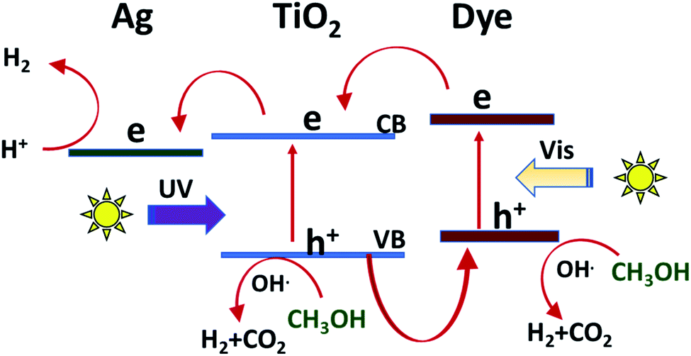
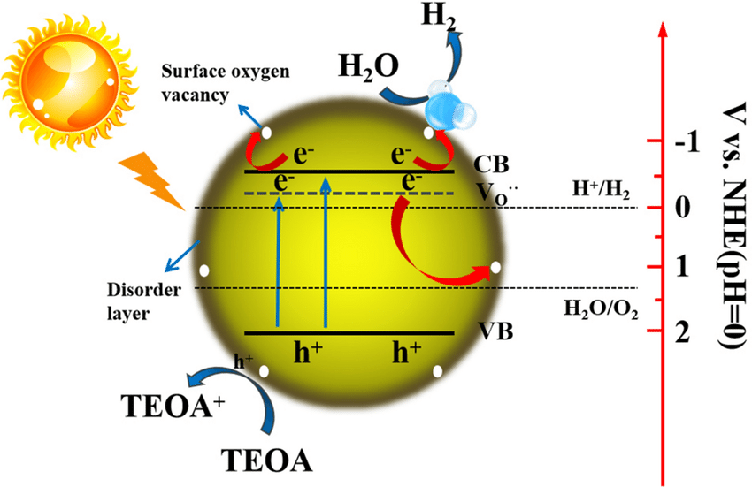

Slide 13
Energy Storage systems
Batteries
Li-ion battery
Li-air battery
Solar cells
Super capacitor
Bulk heterojunction solar cells
Dye sensitized solar cells
Quantum dot sensitized solar
Water splitting
EDL
Pseudo capacitor
Hybrid capacitor
Redox reactions
Solid electrolyte interphase
Helmholtz double layer
Faradaic and non-Faradaic process
Band edge potentials
Charge carrier dynamics
Heterojunction

